Slide 1
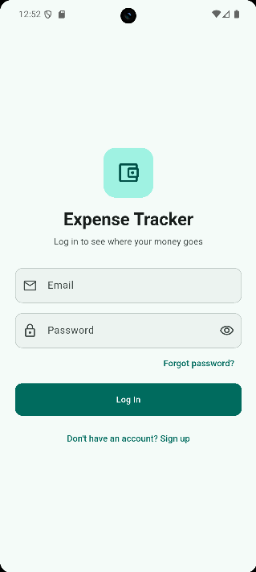
Expense Tracker
FINAL PROJECT PRESENTATION
A secure mobile application for tracking personal expenses
Presented by: Maram Sharaf
Flutter Internship Program · October 2026
Notes:
(20 s) Good morning, everyone. Thank you for joining me. Today I am presenting my final project, Expense Tracker: a secure mobile application that helps users record their daily expenses and understand where their money goes. My name is Maram Sharaf.

Slide 2
Today's presentation
AGENDA
01
Problem and objectives
04
System architecture and technology
02
Proposed solution and features
05
Quality assurance and release
03
Application screens and live demonstration
06
Conclusions, future work and questions
Expense Tracker · Final Project Presentation
02
Notes:
(15 s) The presentation is organised in six parts. I will start with the problem and the objectives, then present the solution and its main features, followed by the application screens and a live demonstration. After that, I will explain the technical architecture, my quality assurance and release process, and finish with my conclusions and your questions.

Slide 3
Small daily expenses are easy to lose track of
01 · PROBLEM STATEMENT
Low visibility
High effort
Privacy concerns
Individually small purchases accumulate into a large share of monthly income without being noticed.
Notebooks and spreadsheets are slow to update, so most people stop recording after a short time.
Financial data is personal and must remain secure and accessible only to its owner.
Objective: build a fast, secure and easy-to-use mobile application for recording and analysing personal expenses.
Expense Tracker · Final Project Presentation
03
Notes:
(50 s) Most people know their income, but not exactly where it is spent. Small daily purchases such as coffee, transport and deliveries accumulate without being noticed. Traditional methods like notebooks or spreadsheets require effort, so people usually stop using them after a short time. In addition, financial data is personal and must be protected. My objective was therefore to build a fast, secure and easy-to-use mobile application for recording and analysing personal expenses.

Slide 4






Six core capabilities
02 · PROPOSED SOLUTION
Secure accounts
Expense management
Monthly summary
Sign up, log in and password reset by email.
Add, view, edit and delete expenses across six categories.
Current month, all-time total and a breakdown by category.
Search and filters
Safe deletion
Personalisation
Search, filter by period and category, and sort four ways.
Swipe to delete with an Undo option and confirmation dialogs.
Light, dark and system themes, remembered between sessions.
Expense Tracker · Final Project Presentation
04
Notes:
(1 min) To address this problem, I developed Expense Tracker, which offers six core capabilities. First, secure user accounts with sign-up, login and password reset by email. Second, complete expense management: users can add, view, edit and delete expenses in six categories. Third, a monthly summary showing the current month's spending, the all-time total and a breakdown by category. Fourth, search, filtering by period and category, and sorting. Fifth, safe deletion with an Undo option. And finally, personalisation through light and dark themes.

Slide 5
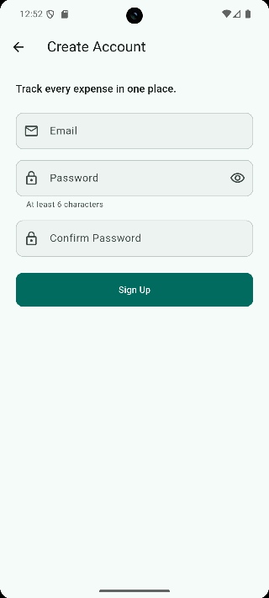
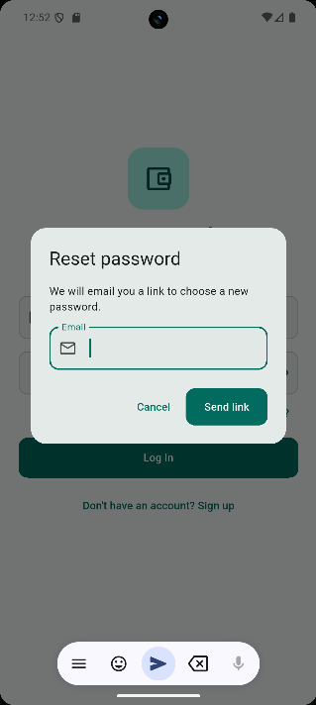
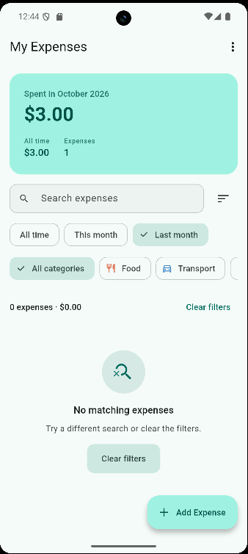
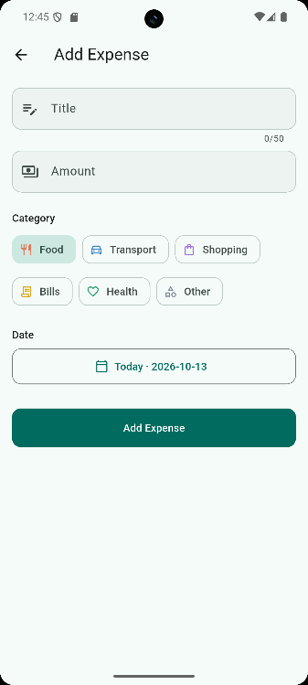
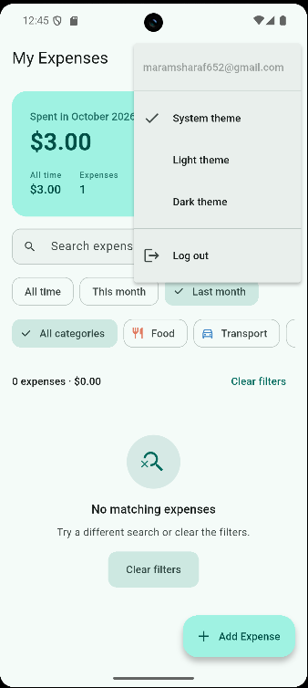
From sign-in to daily tracking
03 · APPLICATION SCREENS
Login
Create account
Reset password
Home
Add expense
Theme and logout
Expense Tracker · Final Project Presentation
05
Notes:
(40 s) These are the main screens of the application. The user starts on the login screen, can create a new account, or request a password reset link by email. After logging in, the home screen shows the monthly summary, the search bar and the filters. From there, the user can add a new expense with a title, amount, category and date. Finally, the menu allows switching between light and dark themes and logging out. I will now demonstrate these screens live.

Slide 6
The application in use
1
Authentication and error messages
03 · LIVE DEMONSTRATION
2
Monthly summary and breakdown
3
Adding an expense with validation
4
Search, filters and sorting
Release build running on an Android device.
5
Editing, deletion and Undo
6
Dark theme and logout
Notes:
(4 min) Switch to the emulator or phone. Follow the demo table in docs/PRESENTATION.md: wrong password message, correct login, summary card, add an expense (empty form errors, invalid amount, then a valid one), search, Last month and category filters, sort by highest, open details, edit, swipe to delete, Undo, dark theme, log out. If anything fails, say: 'Let me show you the recorded version', and play the video. Return to the slides with: 'Let me now explain how the application is built.'

Slide 7
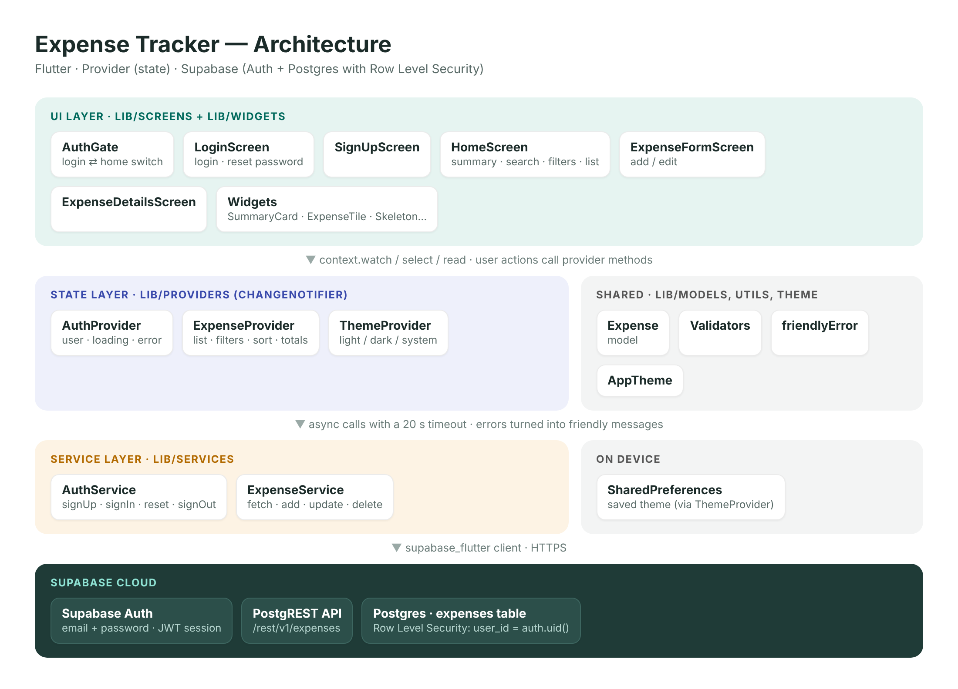
A layered design with a secure backend
04 · SYSTEM ARCHITECTURE
Presentation layer
Screens and widgets render the interface only.
State layer
Providers hold application state and business logic.
Service layer
The only code that communicates with Supabase.
Row Level Security
Each user can access only their own records.
Expense Tracker · Final Project Presentation
07
Notes:
(1 min) The application follows a layered architecture. The presentation layer, made of screens and widgets, is responsible only for the user interface. The state layer uses the Provider package to hold the application state and business logic. The service layer is the only part of the code that communicates with the backend. The backend is Supabase, which provides authentication and a PostgreSQL database. Security is enforced in the database itself through Row Level Security policies, so each user can access only their own records, even if the API is called directly.

Slide 8
Tools and technologies
04 · TECHNOLOGY STACK
Area | Technology | Purpose
Framework | Flutter · Dart 3.13 | One codebase for Android and iOS
State management | Provider | Shares state between screens
Backend | Supabase | Authentication and REST API
Database | PostgreSQL | Stores expenses with Row Level Security
Local storage | SharedPreferences | Remembers the selected theme
Quality | flutter_test · flutter_lints | Automated tests and static analysis
Expense Tracker · Final Project Presentation
08
Notes:
(40 s) This table summarises the technologies used. Flutter allows one codebase to run on Android and iOS. Provider manages the shared state. Supabase provides authentication and a REST API on top of a PostgreSQL database, which stores the expenses and enforces Row Level Security. SharedPreferences stores the user's theme choice on the device, and the official Flutter testing and lint packages ensure code quality.

Slide 9
Verified through testing and analysis
05 · QUALITY ASSURANCE
40
0
20 s
13
Automated tests passed
Static analysis issues
Request timeout
Bugs fixed
Unit and widget tests for validators, providers and screens.
Strict lint rules, including no debug prints.
Network errors become clear, friendly messages.
Found and resolved during feature completion.
Input validation covers edge cases such as NaN, 1e5, negative values and decimal commas.
Expense Tracker · Final Project Presentation
09
Notes:
(50 s) Quality was a priority throughout the project. All 40 automated unit and widget tests pass, and static analysis reports zero issues under strict lint rules. Every network request has a 20-second timeout, and errors are converted into clear messages such as 'No internet connection'. During the feature-completion phase, 13 bugs were identified and fixed. Input validation also covers edge cases such as NaN, scientific notation, negative values and decimal commas.

Slide 10

Version 1.2.0 is ready for release
05 · RELEASE AND DEPLOYMENT
Release APK built successfully (51.3 MB)
ISSUE FOUND IN RELEASE TESTING
Installed and tested on Pixel 7a, Android 16
Missing INTERNET permission
App Bundle setup for Google Play
The permission existed only in the debug configuration, so the release build could not reach the server. It was added to the main manifest and verified on a device.
README, API docs, architecture and release guide
Expense Tracker · Final Project Presentation
10
Notes:
(50 s) For the release, I built a release APK of 51.3 megabytes, and installed and tested it on a Pixel 7a running Android 16. The project is also configured to produce an App Bundle for Google Play. While preparing the release, I found an important issue: the INTERNET permission existed only in the debug configuration, which meant the release version could not connect to the server. I added it to the main manifest and verified the fix on a device. Finally, the project is fully documented with a README, API documentation, an architecture diagram and a release guide.

Slide 11
Lessons learned and future work
06 · CONCLUSIONS
Key lessons
Future work
Separate an application into clear layers
Enforce data security at the database level
Handle edge cases and errors before release
Always test the release build on a device
Monthly budgets with alerts
Spending charts over time
Receipt photo attachments
Excel export and offline synchronisation
Expense Tracker · Final Project Presentation
11
Notes:
(40 s) This project taught me several important lessons: how to separate an application into clear layers, how to enforce data security at the database level, the importance of handling edge cases and errors before release, and that the release build must always be tested on a real device. For future work, I would like to add monthly budgets with alerts, spending charts over time, receipt photos, and Excel export with offline synchronisation.

Slide 12
Thank you
EXPENSE TRACKER
I welcome your questions.
Maram Sharaf
Flutter Internship Program · October 2026
Notes:
(20 s) Thank you for your attention. I would be happy to answer any questions. Prepared answers are in docs/PRESENTATION.md: why Supabase, whether the API key is a risk (no: publishable key plus Row Level Security), why Provider, offline use, the hardest part, iOS support, and testing.

